Slide 1
A Climate Justice Perspective on the Climate Crisis
Dr. Vishwas Satgar
Wits Academic
Board Chairperson COPAC
Climate Justice Activist

Slide 2
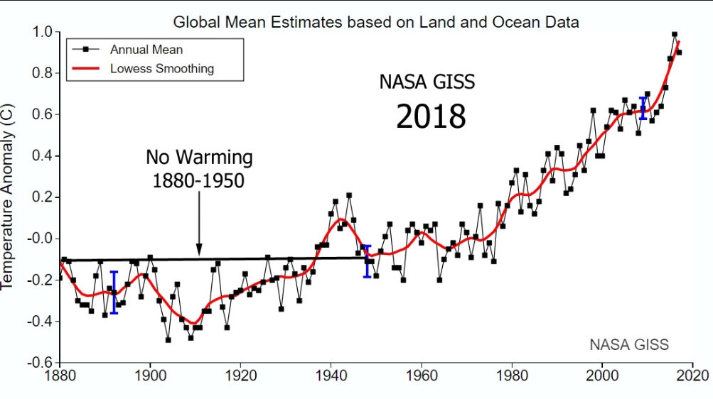

Slide 3
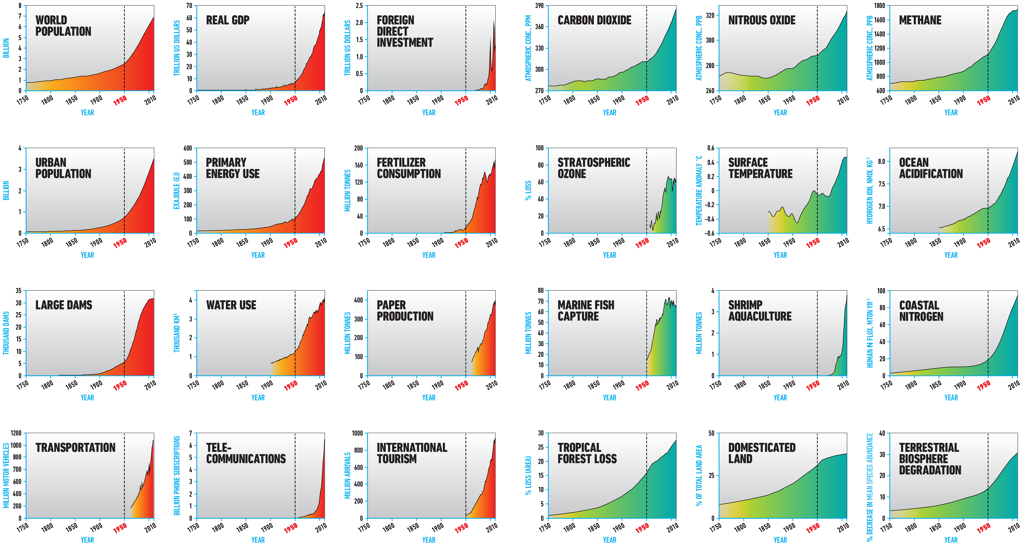
The Great Acceleration
Steffen, Broadgate, Deutsch, Gaffney, Ludwig Anthr. Review 2015. Image: Globaia

Slide 4
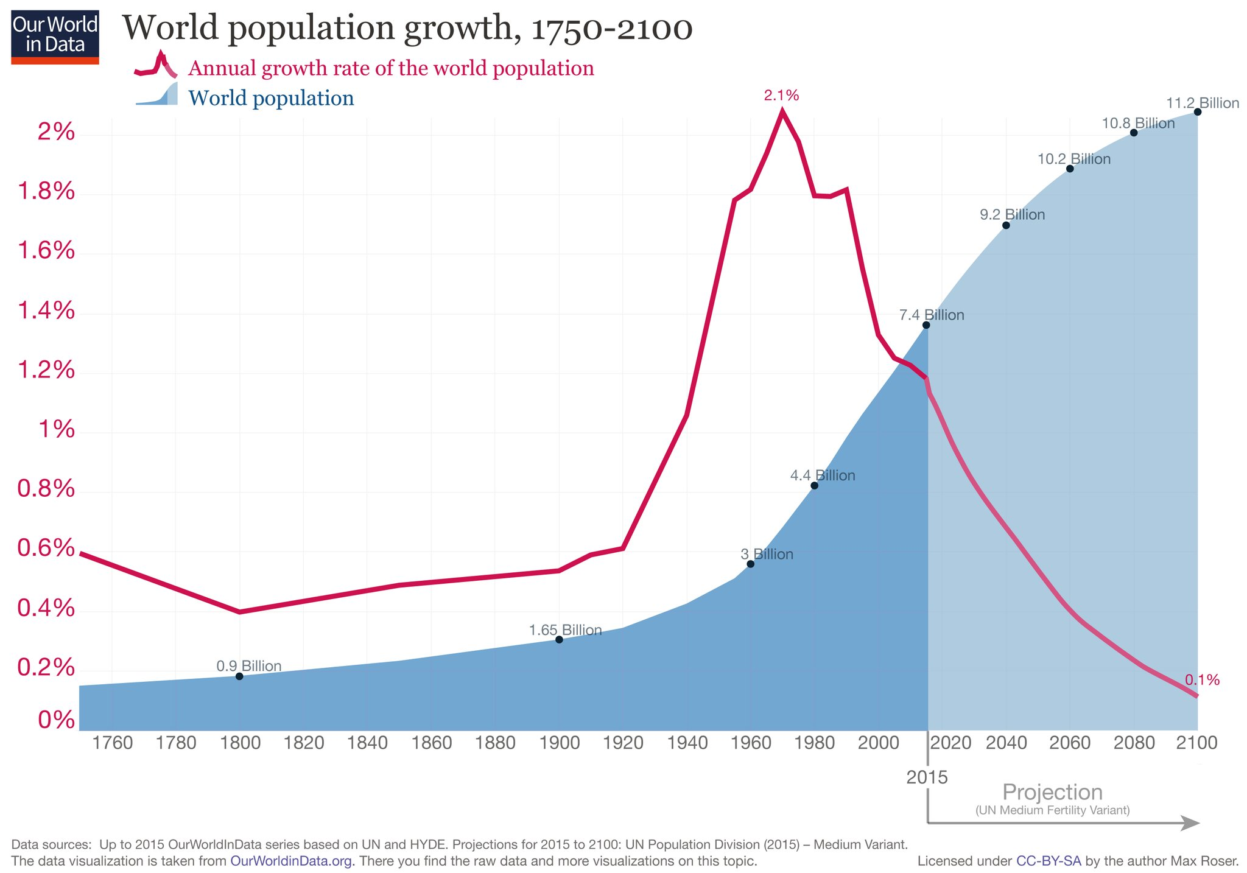
9.7 billion
7.7 billion

Slide 5
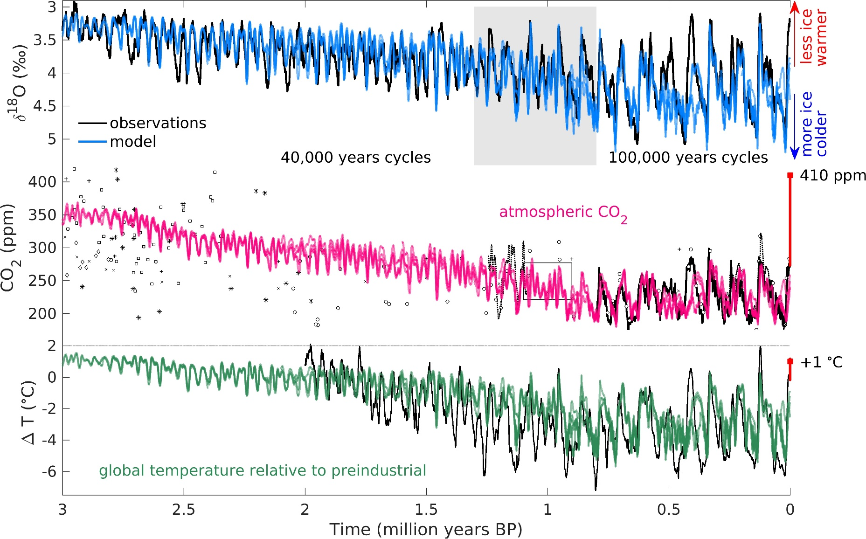
More CO2 in Atmosphere Than Ever in Last 3 Million Years
Results of model simulations: Observations shown in black, model results in colour.
Willeit et al., 2019
Notes:
CO2 greenhouse gas amounts in the atmosphere are likely higher today than ever before in the past 3 million years.
Study shows the first computer simulation that fit ocean floor sediment data of climate evolution over this time period.
The Ice age onset (the start of the glacial cycles from cold to warm and back) was mainly triggered by a decrease of CO2-levels. Today, we are fundamentally altering our planet with increases in CO2 concentrations.
If current climate policy inaction is continued, we would exceed the 2 degrees limit already in the next 50 years.
Background info:
Fig. 2. Transient modeling results. Results of model simulations driven by orbital forcing, optimal regolith removal scenario, and optimal volcanic outgassing scenario. (A) Benthic 18O compared to the stack of (3) (D) Atmospheric CO2 concentration com-pared to ice core data (solid line) and other proxies [circles: (16); squares: (18); *: (51); + and ×: (19); diamonds: (52); black box: (15); dotted lines: (17)] ). (F) Global annual surface air temperature compared to reconstructions (53).
http://advances.sciencemag.org/content/advances/5/4/eaav7337.full.pdf

Slide 6
The Official Climate Change Narrative 1
Earth goes through natural cycles of cooling and heating
International Panel on Climate Change – 2007
human induced climate change – we are in a longer and more
intense warming period…referred to as ‘Anthropocene’
Human population growth is the problem? Darker nations are to blame
Historical and present accumulations of green-house gases –
( like carbon, methane) – 150 years of fossil fuels,
50 years ago golden spike

Slide 7
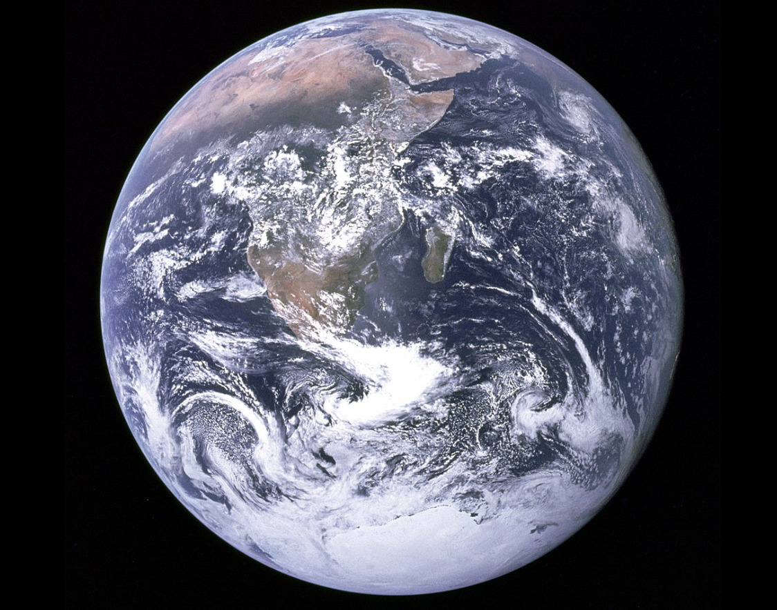
Are we leaving our
Garden of Eden?

Slide 8
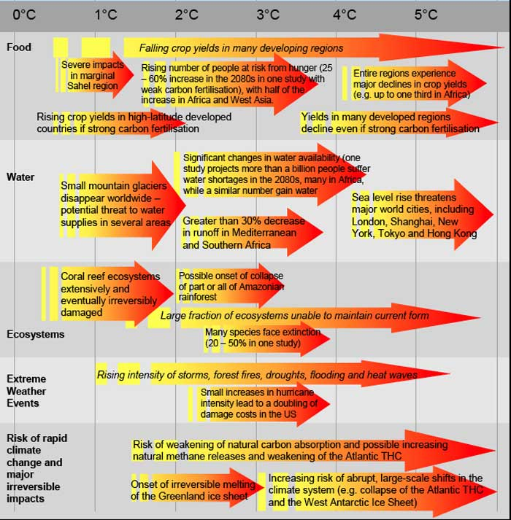
Source : Stern Review : Economics of Climate Change, 2007

Slide 9
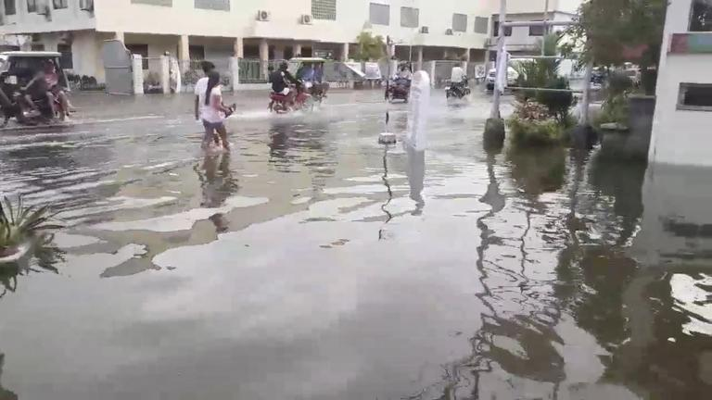
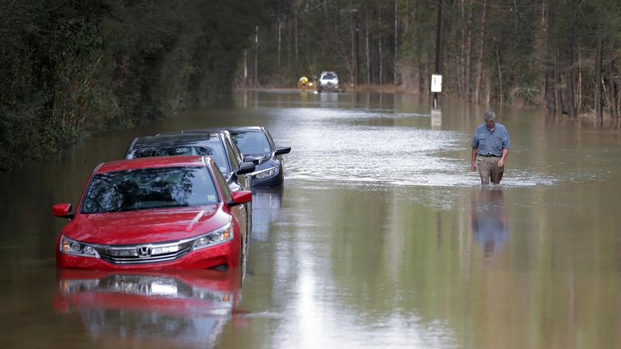
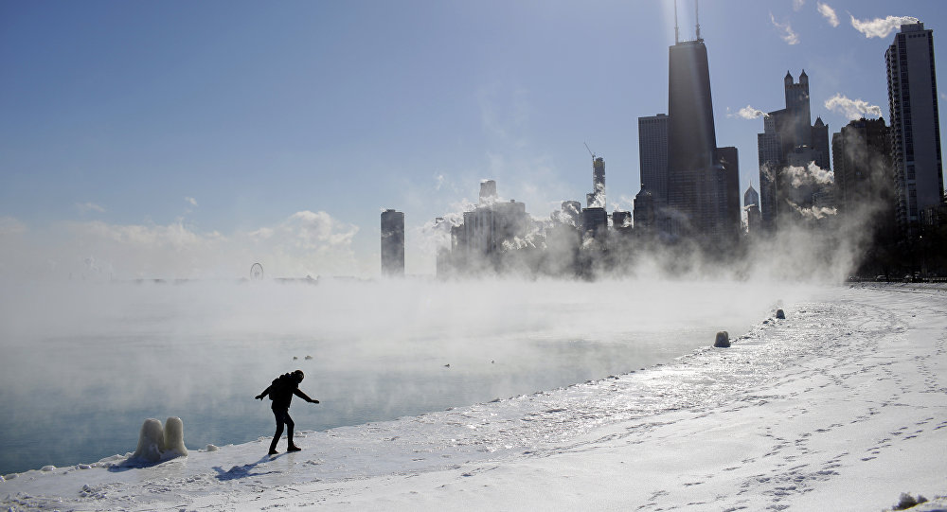

Extreme weather around the globe 2018/19
Heavy rainfall and landslides
in the Philippines
Heavy precipitation in the
South of the USA
Devastation from Cyclone Idai
Blizzards in the Mid-West of the USA
Record heatwave in Australia
Notes:
Highest temperature measured in Tarcoola: 49,1 °C

Slide 10

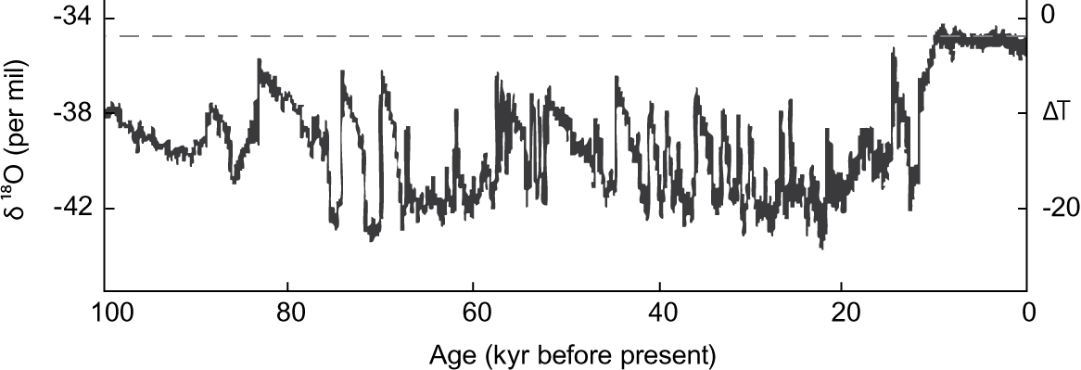

Humanity’s 10,000 years of grace

Slide 11
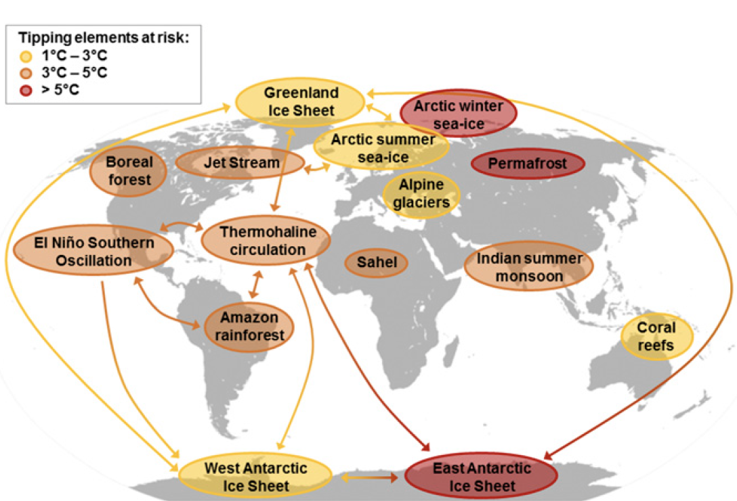
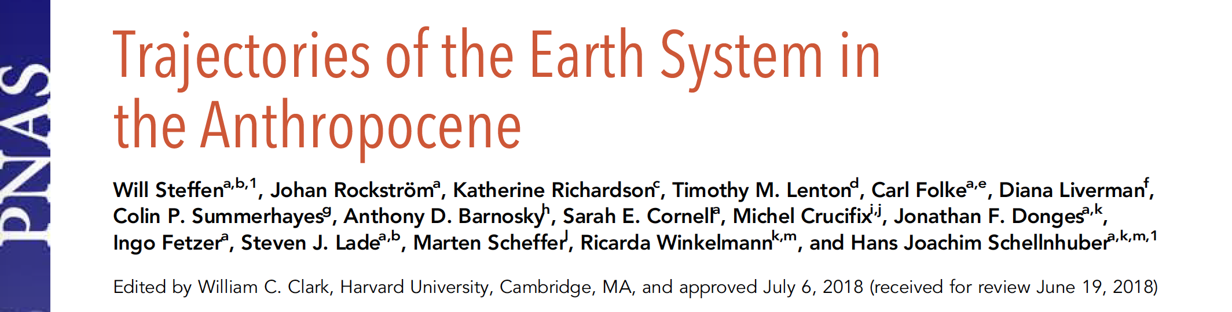
A Global Map of Potential Tipping Cascades
Notes:
Transition slide that shows tipping elements and potential cascades. This leads to a video illustrating the risk of entering a ‚Hothouse Earth‘ trajectory.

Slide 12
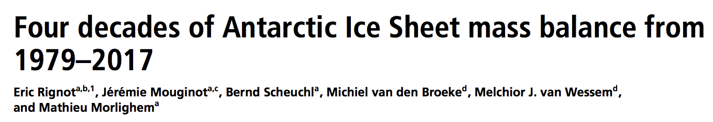
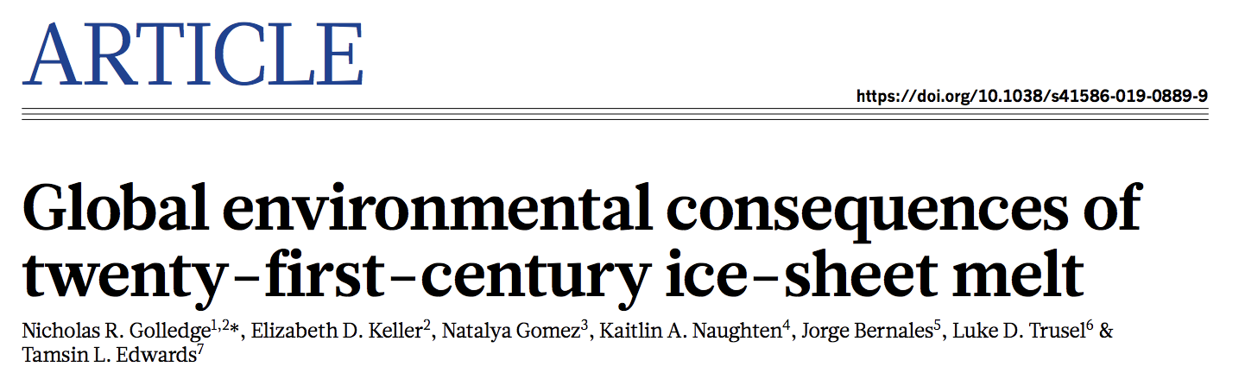
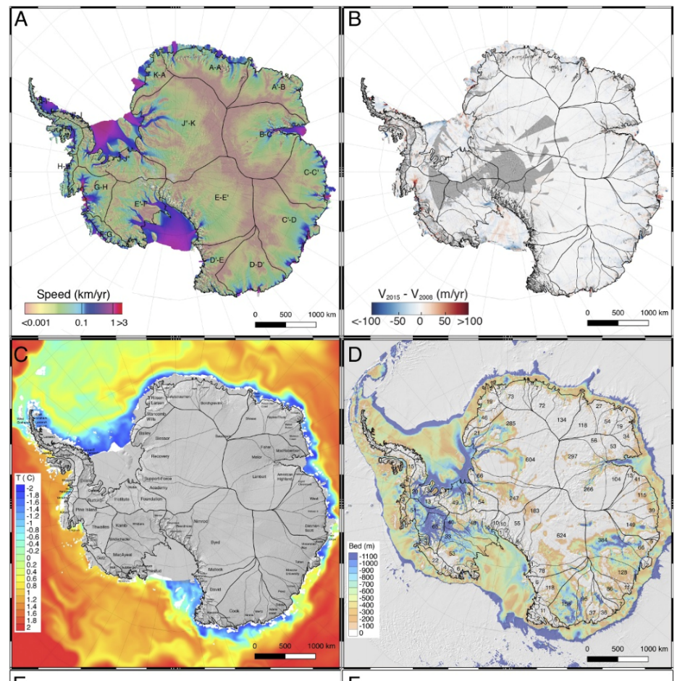
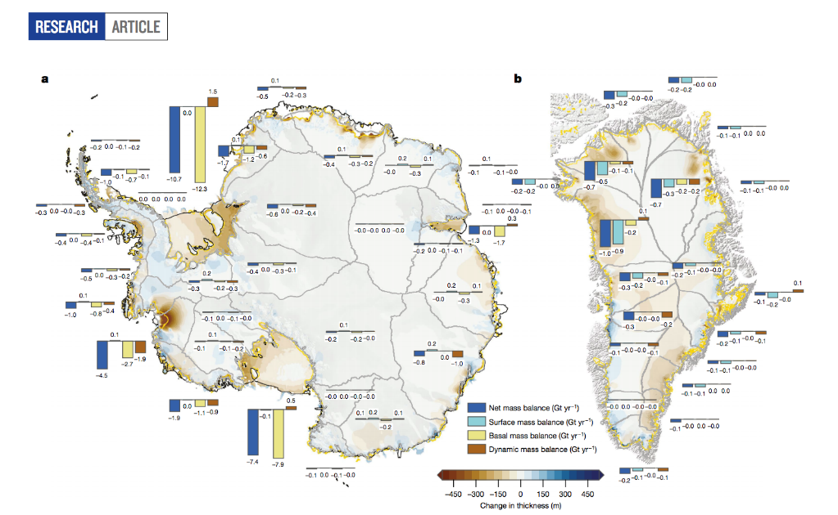
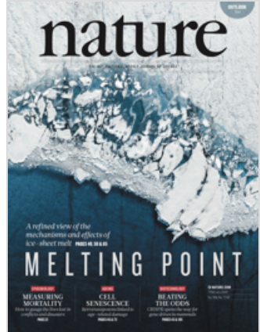
Antarctica melting faster than predicted

Slide 13
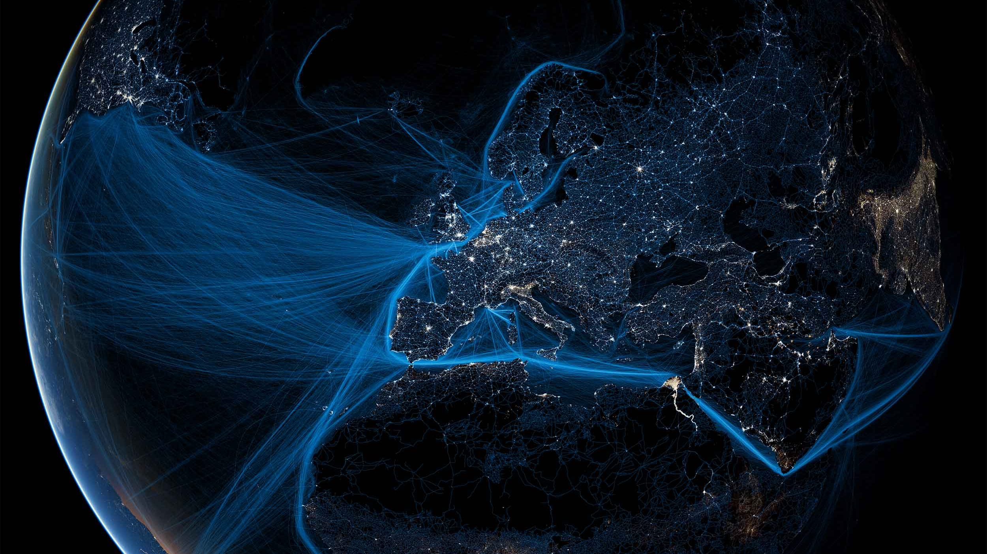
Entering The Anthropocene
(Official Climate Change Narrative 2)
+
Holocene Our Garden of Eden
+
Tipping Points hardwired ???
=
PLANETARY COMMONS?
Image: GLOBAIA
Notes:
Welcome to the Anthropocene Video – auto transition to video and then to next slide –to this after the video.

Slide 14
What is Climate Justice?
Political economy critique – who is responsible for climate crisis? How does capitalism create the climate crisis?
Deep just transition – system change through systemic alternatives
Recognise race, gender and class impacts of climate shocks – new inequalities – justice 1
Human and non-human life are part of nature – planetary eco-system – justice 2
Present and future generations – inter-generational Justice 3.
Building a powerful and independent grassroots movement – an alliance of forces for deep transformation

Slide 15
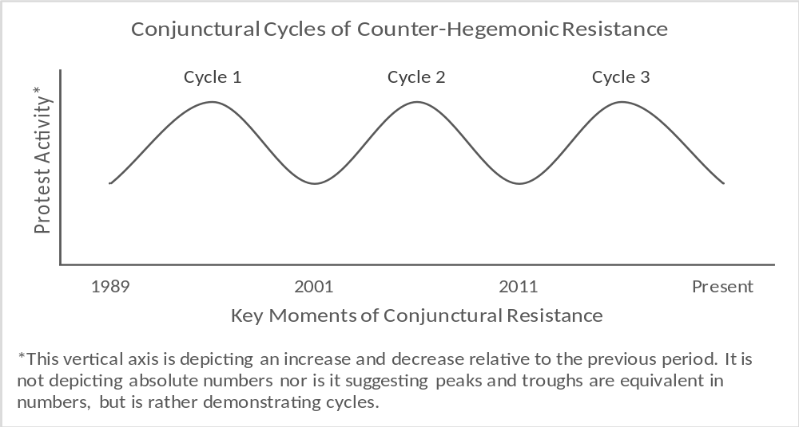
The Rise of Climate Justice Forces

Slide 16
The Conjuncture - Crisis in Neoliberalism Not Of Neoliberalism
Upswing in cycle of struggle against neoliberalism (1999) – but not deep enough in terms of counter-hegemonic shift – labour has not been able to articulate and win alternatives to neoliberalism – defensive and episodic
Strength of capital – 2007 -2009 – capital defended gains – too big to fail – bail outs, partial nationalisation – socialising costs of crisis through austerity
Mutation in neoliberalism – Green neoliberalism? Using valorisation of nature as fix/outlet
Not hegemonic but supremacist and increasingly becoming authoritarian, ethno nationalist – rise of neo fascism?

Slide 17
Beyond the Conjuncture - The Crisis of Capitalist Business Civilisation
4 general crises of capitalism – late 19th C, 1929, 1973 and circa 2007 to now
Systemic level and planetary scale despite uneven development
We are all ‘Americans’
Beyond boom/bust cycles or overproduction and instabilities of financialisation
Inter-lock of systemic crisis tendencies – climate change, oil peak, food crisis, unstable financialised capitalism and securitisation – crisis of eco-reproduction of society
Global transition ?

Slide 18
The Climate Crisis As Systemic Crisis of Accumulation
Complex problem like climate change has to be located in capitalist accumulation – relationship between conjunctural and systemic
150 years of carbon extraction and fossil fuel use
500 years of human and eco-system destruction
Facing species extinction – 1 degree increase plus more
Capital and imperialism the geological forces shaping planetary conditions
Climate shocks impact life supporting systems, recurrent
Inter-locks with food system, water system crisis, resource peak, inequality
Ecocidal logic of capitalism - undermining planetary conditions that sustain life – crises of capitalist civilisation
Ecocide is a materialist, historic and contextual category

Slide 19
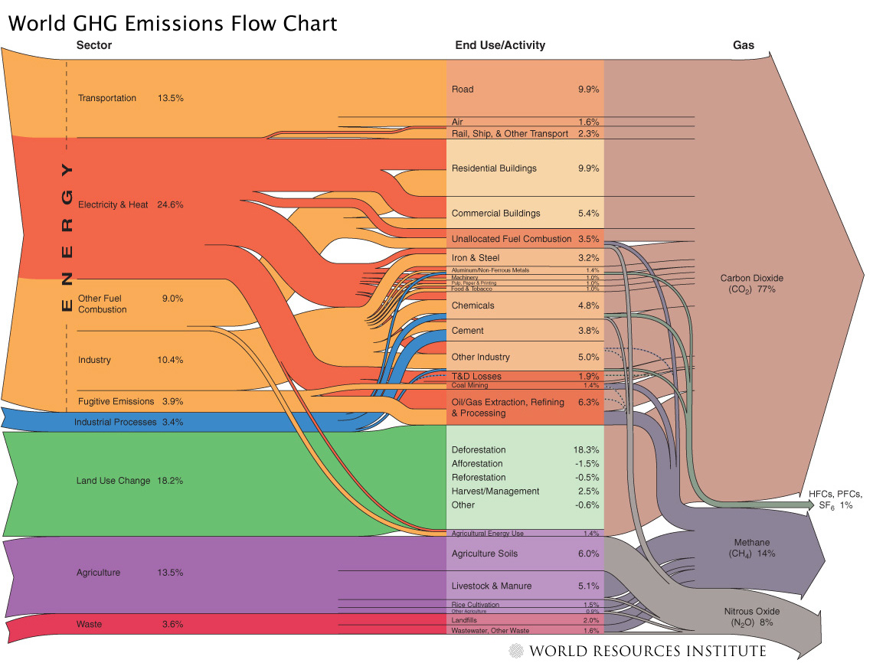

Slide 20
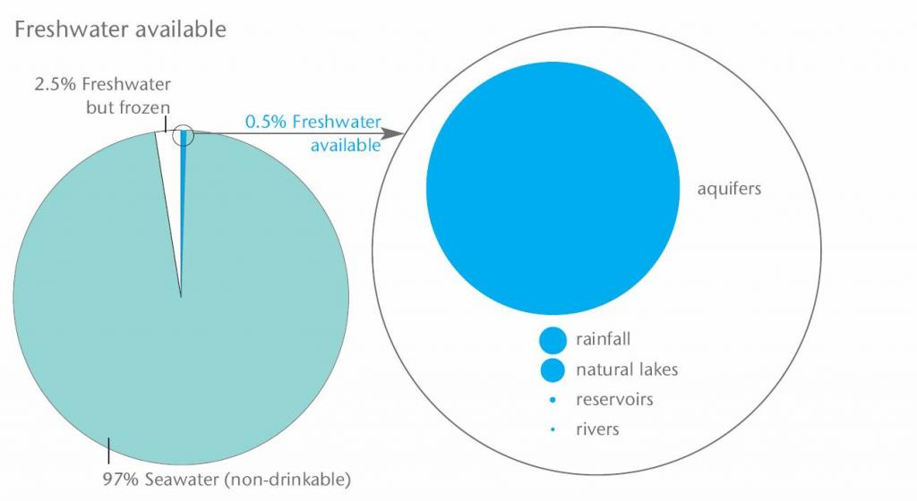
Source: WBCSD (2009)

Slide 21


Only 60 Years of Farming left if Soil Degradation continues

Slide 22
Climate Crisis Realities and the Global Gas Chamber - Anthropocene 2
UN Multilateral system has failed – crisis of global leadership – capture by carbon capital
Science – UN report, 1.5C and closing window – 12 years to bring down carbon emissions to 45% at 2010 levels and by 2050 net zero – linear
Past 4 years hottest years on record
Extreme weather shocks – costs, planetary zone of chaos
200 million will be displaced in Africa alone – Africa heating twice the global average
Global emissions increasing not coming down
Energy demand increasing – unvirtuos cycle of consumption
Global energy mix still dominated by coal (38%), Other non fossil fuel (36) and rest gas and oil
Renewables not keeping up and flatlining

Slide 23
SAs Carbon Criminality
Highest carbon emitter in Africa
Carbon intensity worse than China, India and Brazil
Amongst the 4/5 top polluters = G20
20 000 killed from pollution annually – Eskom???
Just transition discourse is a joke
None of the parties serious about climate crisis including recent shocks
ANC – 20th century industrialisation, resource nationalism, carbon centric growth (ESKOM and credit ratings)
SA Government leaning towards 2050 for net zero!

Slide 24
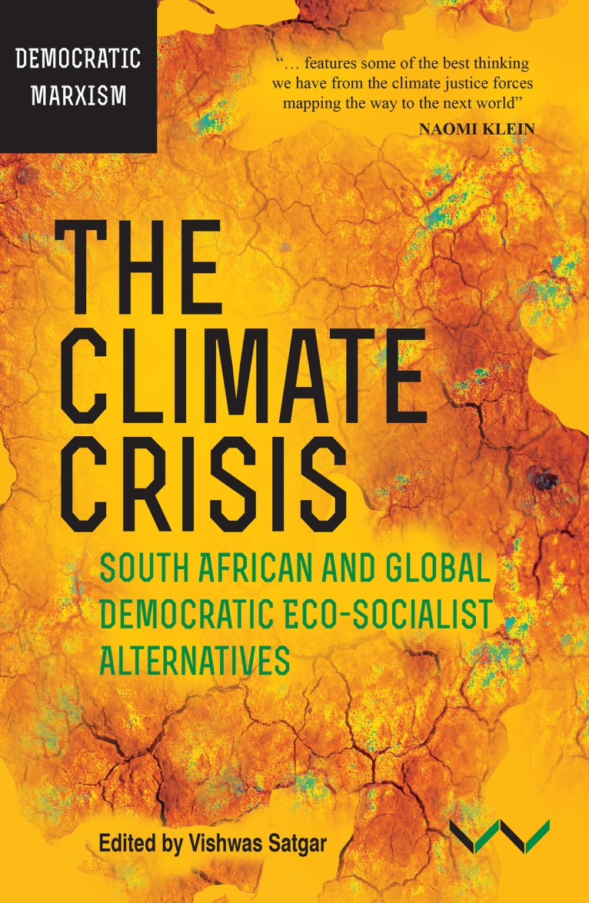

Slide 25
Food Sovereignty in South Africa
Animation: The hidden story behind hunger
https://www.youtube.com/watch?v=AYHybn0QdYA

